Slide 1
Non-linear models and analyzing results with R

Slide 2
Run models
Growth
Recruitment
Practice reading and viewing results in R

Slide 3
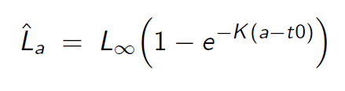
Von Bertalanffy growth
Start with “vonbert1.tpl”
Save as “vonbert2.tpl”
Calculate standard deviations of predicted length
Add REPORT_SECTION
Plot results in R with “vonbert.R”

Slide 4
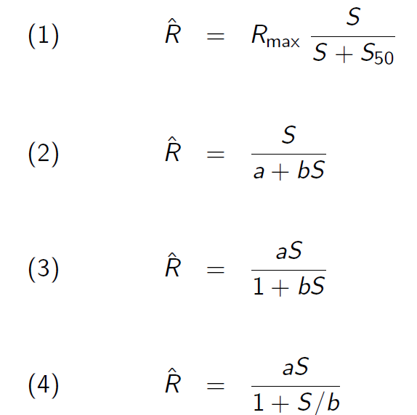
Beverton-Holt stock-recruit parameterizations
Run a few parameterizations of Beverton-Holt recruitment
Read results into single R script to compare in one figure
Repeat for Ricker curve and compare models

Slide 5
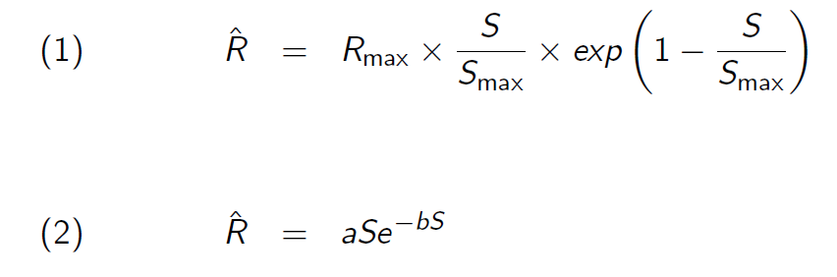
Ricker stock-recruit parameters

Slide 6
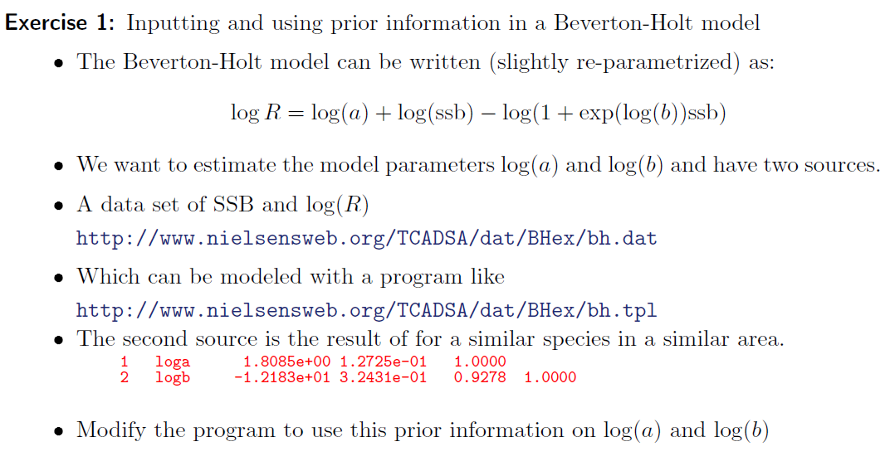
Exercise

Slide 7
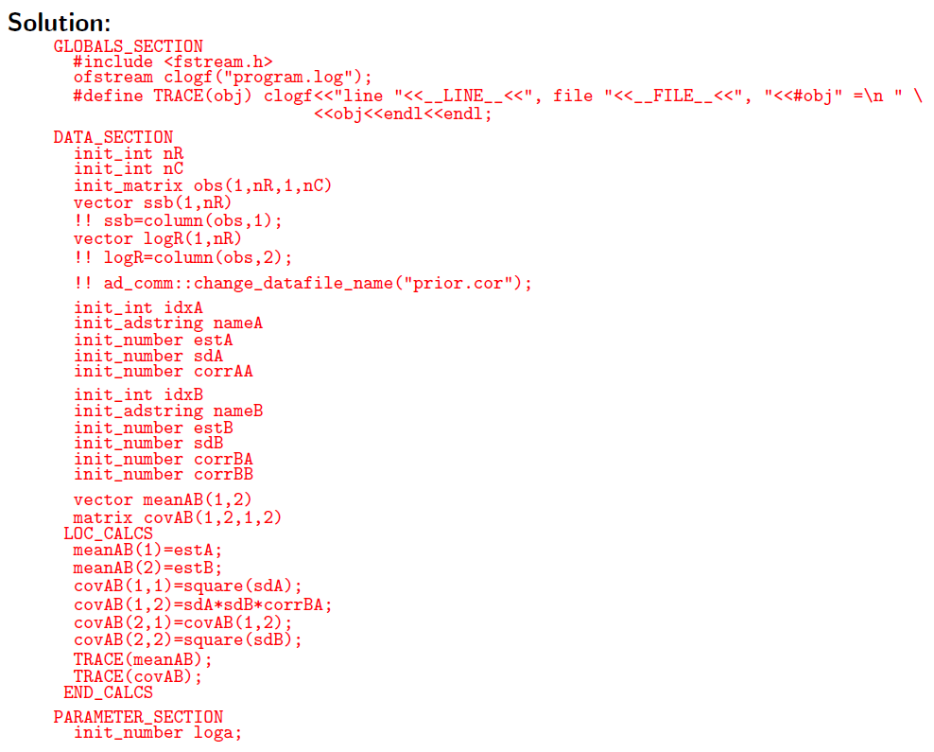

Slide 8
